Slide 1

SOKOINE UNIVERSITY OF AGRICULTURE
School of Engineering and Technology | Department of Agricultural Engineering
AEN 214: INTRODUCTION TO ELECTRONICS — LECTURE 9
Boolean Algebra & Karnaugh Maps
Axioms, De Morgan's Theorems, Canonical SOP/POS, 2/3/4-Variable K-Maps, Don't-Cares & Glitch Elimination
Course Instructor: Dr. Kadeghe Goodluck Fue, PhD, P.Eng (T)
Electronics & Precision Agriculture Laboratory | Academic Year 2025/2026 | Sokoine University of Agriculture
Sokoine University of Agriculture | School of Engineering & Technology | Department of Agricultural Engineering
Slide 1 of 26

Slide 2
AEN 214: INTRODUCTION TO ELECTRONICS
Lecture 9 Learning Outcomes & Optimization Scope
• Master Boolean Axioms & Theorems: Identity, Null, Idempotent, Involution, Complementarity, and Absorption laws.
• Apply the Principle of Duality: Dual transformations of Boolean identities and equivalent electrical contact networks.
• Prove De Morgan's Laws: Rigorous mathematical induction and algebraic expansion across multi-variable expressions.
• Evaluate Canonical & Standard Forms: Canonical Sum-of-Products (minterms m_i) and Product-of-Sums (maxterms M_i).
• Construct Karnaugh Maps (K-Maps): 2-variable, 3-variable, and 4-variable maps labeled in Gray code sequence.
• Extract Minimal SOP/POS Equations: Toroidal wrap-around adjacency, corner quads, Essential Prime Implicants (EPIs).
• Exploit Don't-Care Conditions (X / d): Optimize BCD alarms and eliminate Static-1 hazards using consensus product terms.
Sokoine University of Agriculture | School of Engineering & Technology | Department of Agricultural Engineering
Slide 2 of 26

Slide 3
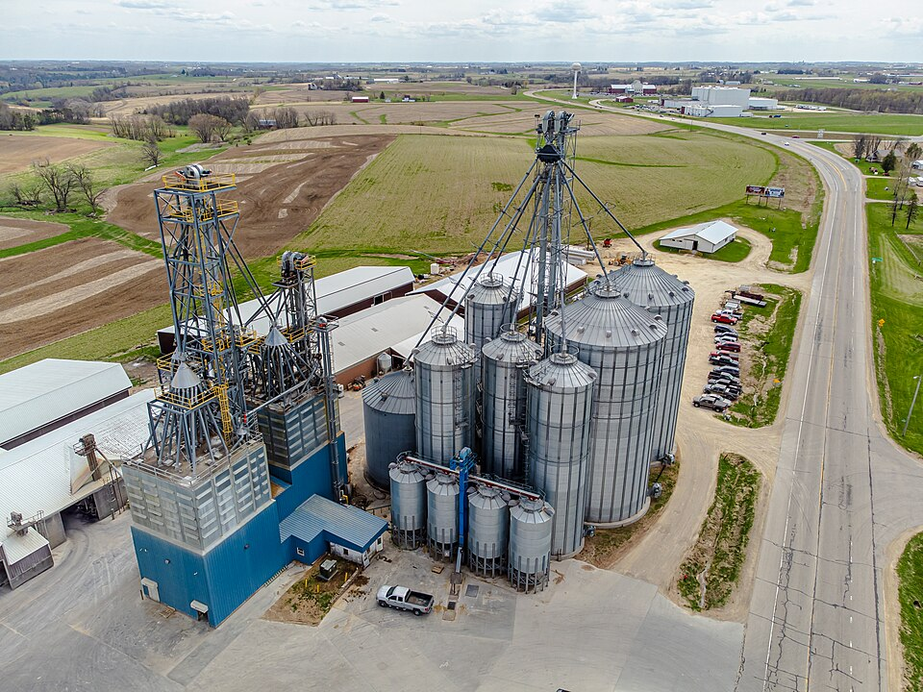
AEN 214: INTRODUCTION TO ELECTRONICS
Logic Minimization in Commercial Agriculture
• Reducing Silicon Cost & Power: Unsimplified logic requires dozens of gate ICs; minimized logic fits in a single low-power chip.
• Accelerating Machine Response: Fewer cascaded gate levels reduce total propagation delay, enabling faster emergency braking.
• Improving Vibration Reliability: Every unneeded IC package eliminated removes 14 solder joints that could crack on vibrating tractors.
• Exploiting Impossible States (Don't-Cares): Agricultural sensors have physical constraints (e.g. BCD values 10-15 never occur).
• Eliminating Safety Glitches: Static-1 hazards cause momentary false sensor trips, dumping hydraulic fluid or stopping irrigation pumps.
Sokoine University of Agriculture | School of Engineering & Technology | Department of Agricultural Engineering
Slide 3 of 26

Slide 4
AEN 214: INTRODUCTION TO ELECTRONICS
Foundations of Boolean Algebra: Axioms & Postulates
• Huntington's Postulates: Mathematical algebraic system defined over set B = {0, 1} with two binary operators: AND (·) and OR (+).
• Closure: For all A, B in {0, 1}: A · B in {0, 1} and A + B in {0, 1}.
• Identity Elements: Identity for OR is 0: A + 0 = A; Identity for AND is 1: A · 1 = A.
• Commutative Laws: A + B = B + A; A · B = B · A (Order of operands does not affect logical result).
• Distributive Laws: A · (B + C) = (A · B) + (A · C); AND distributes over OR.
• Second Distributive Law: A + (B · C) = (A + B) · (A + C); OR distributes over AND (Unique to Boolean algebra!).
• Complementarity Laws: A + /A = 1; A · /A = 0.
Sokoine University of Agriculture | School of Engineering & Technology | Department of Agricultural Engineering
Slide 4 of 26

Slide 5
AEN 214: INTRODUCTION TO ELECTRONICS
Core Boolean Algebraic Theorems & Laws
• Idempotent Laws: A + A = A; A · A = A (Combining identical terms yields no change).
• Null (Dominance) Laws: A + 1 = 1; A · 0 = 0 (Dominant elements overwrite variable).
• Involution Law (Double Negation): //A = A.
• Associative Laws: (A + B) + C = A + (B + C); (A · B) · C = A · (B · C).
• Absorption (Redundancy) Laws: A + (A · B) = A; A · (A + B) = A; A + (/A · B) = A + B.
• Consensus Theorem: A · B + /A · C + B · C = A · B + /A · C (The redundant term B · C can be eliminated!).
• Principle of Duality: Any true Boolean identity remains true if: (1) AND and OR are swapped, and (2) 0 and 1 are swapped.
Sokoine University of Agriculture | School of Engineering & Technology | Department of Agricultural Engineering
Slide 5 of 26

Slide 6
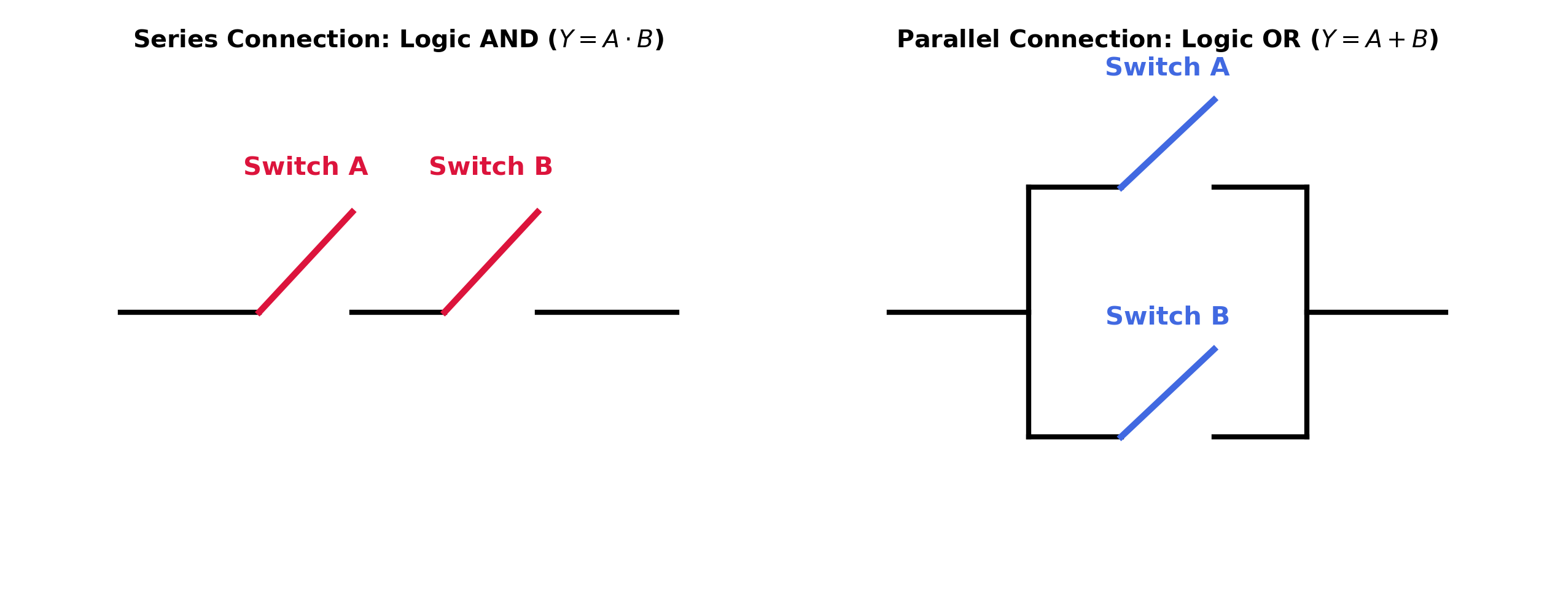
AEN 214: INTRODUCTION TO ELECTRONICS
De Morgan's Theorems & Electrical Switching Circuits
• First Law: The complement of a product equals the sum of the complements: /(A · B) = /A + /B.
• Second Law: The complement of a sum equals the product of the complements: /(A + B) = /A · /B.
• Generalized N-Variable Form: /(X_1 · X_2 · ... · X_N) = /X_1 + /X_2 + ... + /X_N.
• Series-Parallel Switching Duality: Two normally-closed contacts in series break circuit if EITHER opens: /(A + B) = /A · /B.
• Gate Transformation Rule: A NAND gate is logically equivalent to a Negative-OR gate (OR with inverted inputs).
• Gate Transformation Rule: A NOR gate is logically equivalent to a Negative-AND gate (AND with inverted inputs).
Sokoine University of Agriculture | School of Engineering & Technology | Department of Agricultural Engineering
Slide 6 of 26

Slide 7
AEN 214: INTRODUCTION TO ELECTRONICS
Canonical Boolean Forms: Minterms & Maxterms
• Minterm (Standard Product Term, m_i): A product term containing EVERY system variable exactly once in either true or complemented form.
• Minterm Evaluation: A minterm produces logic '1' for exactly ONE row of the truth table (e.g. for row 101_2: m_5 = A · /B · C).
• Canonical Sum-of-Products (SOP): The logical OR of all minterms for which output Y = 1: Y = Sum m(1, 3, 5, 7).
• Maxterm (Standard Sum Term, M_i): A sum term containing EVERY system variable exactly once in either true or complemented form.
• Maxterm Evaluation: A maxterm produces logic '0' for exactly ONE row of the truth table (e.g. for row 010_2: M_2 = A + /B + C).
• Canonical Product-of-Sums (POS): The logical AND of all maxterms for which output Y = 0: Y = Prod M(0, 2, 4, 6).
• Complementary Relationship: Sum m(List_1) = Prod M(List_2), where List_1 and List_2 partition all 2^N rows.
Sokoine University of Agriculture | School of Engineering & Technology | Department of Agricultural Engineering
Slide 7 of 26

Slide 8
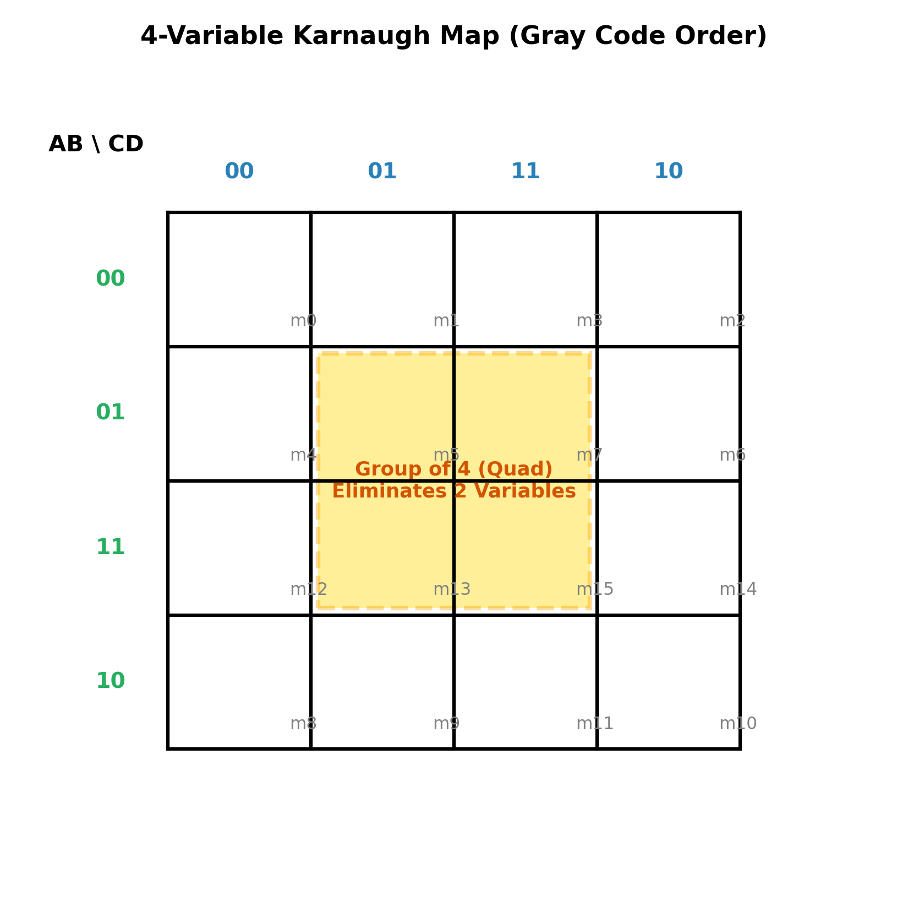
AEN 214: INTRODUCTION TO ELECTRONICS
The Karnaugh Map: Geometric 2D Adjacency
• Visual Minimization Matrix: A 2D graphical representation of a truth table where logical adjacency corresponds to physical geometric adjacency.
• Gray Code Labeling: Adjacent row and column coordinates are ordered in Gray code: 00, 01, 11, 10 (NEVER standard binary 00, 01, 10, 11!).
• The Unit-Distance Property: Moving one cell horizontally or vertically changes EXACTLY ONE binary variable (e.g. 01 to 11 changes only bit 1).
• Cell Count: An N-variable K-map contains exactly 2^N cells (2-var = 4 cells; 3-var = 8 cells; 4-var = 16 cells).
• Toroidal Topology: The K-map is geometrically continuous (a torus); the top edge wraps to bottom edge, and left edge wraps to right edge!
Sokoine University of Agriculture | School of Engineering & Technology | Department of Agricultural Engineering
Slide 8 of 26

Slide 9
AEN 214: INTRODUCTION TO ELECTRONICS
Rigorous K-Map Grouping (Implicant) Rules
• Rule 1 (Power of 2): Groups must contain a number of cells that is a power of 2: 1 (single), 2 (pair), 4 (quad), 8 (octet), 16 (hexadecet).
• Rule 2 (Rectangular Geometry): Groups must form solid rectangles or squares; diagonal or L-shaped groupings are strictly forbidden.
• Rule 3 (Variable Elimination): Combining 2 cells eliminates 1 variable; 4 cells eliminates 2 variables; 8 cells eliminates 3 variables!
• Rule 4 (Maximal Group Size): Always form the LARGEST possible groups first; larger groups yield simpler terms with fewer literals.
• Rule 5 (Overlapping Groups): 1-cells may be shared by multiple groups if doing so enlarges adjacent groups.
• Rule 6 (Essential Prime Implicants): A group is an EPI if it covers at least one '1' that is not covered by any other group; MUST be included.
Sokoine University of Agriculture | School of Engineering & Technology | Department of Agricultural Engineering
Slide 9 of 26

Slide 10
AEN 214: INTRODUCTION TO ELECTRONICS
Worked Engineering Example 1: 3-Variable K-Map Minimization for Drip Irrigation Pump
PROBLEM SPECIFICATION & AGRICULTURAL CONTEXT:
A solar-powered drip irrigation pump at Kilombero Sugar nursery operates according to 3 binary sensor inputs: Reservoir Water Available (A), Soil Moisture Deficit (B), and Solar Irradiance High (C). The truth table defines the pump enable function as: Y(A, B, C) = Sum m( 1, 3, 4, 5, 6, 7 ). (a) Plot the minterms on an 8-cell Karnaugh map, (b) Form the maximal groups of 1-cells, (c) Determine the essential prime implicants and write the minimal SOP expression.
STEP-BY-STEP MATHEMATICAL SOLUTION & VERIFICATION:
1. Construct 3-Variable K-Map (Row A [0, 1]; Columns BC [00, 01, 11, 10]):
• Row A=0: Cell 0=0, Cell 1=1, Cell 3=1, Cell 2=0.
• Row A=1: Cell 4=1, Cell 5=1, Cell 7=1, Cell 6=1.
2. Identify Maximal Groups of 1-cells:
• Group 1 (Entire Row A=1): Cells (4, 5, 7, 6). Variables B and C vary through (00, 01, 11, 10), while A remains constant at 1.
Reduced Product Term 1 = **A** (eliminates 2 variables: B and C).
• Group 2 (Quad of 4): Columns BC=01 and BC=11 across both rows (Cells 1, 3, 5, 7). Variable A varies (0 and 1), B varies (0 and 1), while C remains constant at 1.
Reduced Product Term 2 = **C** (eliminates 2 variables: A and B).
3. Completeness Check: All six 1-cells (1, 3, 4, 5, 6, 7) are completely covered by Group 1 and Group 2.
4. Final Minimal SOP Expression: **Y = A + C**.
5. Hardware Impact: The raw canonical expression required six 3-input AND gates and one 6-input OR gate (25 transistors). The K-map minimized it to a single 2-input OR gate (6 transistors)—a 76% hardware reduction!
Sokoine University of Agriculture | School of Engineering & Technology | Department of Agricultural Engineering
Slide 10 of 26

Slide 11
AEN 214: INTRODUCTION TO ELECTRONICS
4-Variable K-Maps: Corner & Toroidal Wrap-Around
• 16-Cell Architecture: Rows labeled AB [00, 01, 11, 10]; Columns labeled CD [00, 01, 11, 10].
• Toroidal Edge Adjacencies: Row 00 is adjacent to Row 10 (top to bottom); Column 00 is adjacent to Column 10 (left to right).
• The Four-Corner Quad: Cells (0, 2, 8, 10) form a valid, highly efficient Quad of 4!
• Elimination Across 4 Corners: Across rows 00 and 10: A varies, B=0 (/B). Across columns 00 and 10: C varies, D=0 (/D).
• Reduced Corner Term: The four corners combine into the compact product term: **/B · /D**.
• Center 2x2 Quad: Cells (5, 7, 13, 15) combine into product term: **B · D**.
Sokoine University of Agriculture | School of Engineering & Technology | Department of Agricultural Engineering
Slide 11 of 26

Slide 12
AEN 214: INTRODUCTION TO ELECTRONICS
Worked Engineering Example 2: 4-Variable K-Map Minimization for Greenhouse Climate Fan
PROBLEM SPECIFICATION & AGRICULTURAL CONTEXT:
An automated greenhouse climate controller in Morogoro monitors 4 binary sensors: Temperature High (A), Humidity High (B), Light High (C), and CO2 Low (D). The exhaust ventilation fan function is defined by: F(A, B, C, D) = Sum m( 0, 2, 5, 7, 8, 10, 13, 15 ). (a) Populate the 16-cell K-map, (b) Identify the toroidal wrap-around and center groups, (c) Extract the minimal SOP expression, (d) Express in XOR/XNOR logic.
STEP-BY-STEP MATHEMATICAL SOLUTION & VERIFICATION:
1. Populate 16-Cell K-Map (Rows AB, Columns CD):
• Row AB=00: Cell 0=1, Cell 1=0, Cell 3=0, Cell 2=1.
• Row AB=01: Cell 4=0, Cell 5=1, Cell 7=1, Cell 6=0.
• Row AB=11: Cell 12=0, Cell 13=1, Cell 15=1, Cell 14=0.
• Row AB=10: Cell 8=1, Cell 9=0, Cell 11=0, Cell 10=1.
2. Form Maximal Groups:
• Group 1 (Four Corners): Cells (0, 2, 8, 10).
- Rows 00 & 10: A cancels (0 and 1), B remains 0 -> /B.
- Columns 00 & 10: C cancels (0 and 1), D remains 0 -> /D.
- Reduced Term 1 = **/B · /D**.
• Group 2 (Center 2x2 Quad): Cells (5, 7, 13, 15).
- Rows 01 & 11: A cancels, B remains 1 -> B.
- Columns 01 & 11: C cancels, D remains 1 -> D.
- Reduced Term 2 = **B · D**.
3. Minimal SOP Expression: **F = /B · /D + B · D**.
4. Gate Realization: Notice that /B·/D + B·D is the exact definition of Exclusive-NOR! **F = /(B ⊕ D)**.
5. Brilliant Hardware Simplification: The complex 4-sensor system simplifies to a single 2-input XNOR gate comparing B and D!
Sokoine University of Agriculture | School of Engineering & Technology | Department of Agricultural Engineering
Slide 12 of 26

Slide 13
AEN 214: INTRODUCTION TO ELECTRONICS
Don't-Care Conditions (d / X) in Digital Design
• Physical Origin: Input combinations that can NEVER physically occur due to hardware constraints, or whose output is irrelevant.
• BCD Illegal States: In 4-bit Binary Coded Decimal, inputs 1010_2 through 1111_2 (10 to 15) are illegal; their outputs are Don't-Cares.
• K-Map Optimization Rule: Treat Don't-Care cells (X) as '1' IF doing so enlarges a group; treat them as '0' if they do not help.
• No Obligation Rule: You are NEVER obligated to cover a Don't-Care cell; only cover them if they enlarge valid 1-cell groups.
• Hardware Benefit: Incorporating Don't-Cares frequently allows pairs to become quads, and quads to become octets, cutting gate count by > 50%!
Sokoine University of Agriculture | School of Engineering & Technology | Department of Agricultural Engineering
Slide 13 of 26

Slide 14
AEN 214: INTRODUCTION TO ELECTRONICS
Worked Engineering Example 3: Exploiting Don't-Cares for BCD Grain Moisture Scale Alarm
PROBLEM SPECIFICATION & AGRICULTURAL CONTEXT:
A digital grain moisture scale at Morogoro NFRA depot outputs a 4-bit BCD digit (bits A, B, C, D where A is MSB). An alarm must trip (Y = 1) if moisture exceeds safe thresholds, corresponding to decimal digits 7, 8, 9: Y = Sum m( 7, 8, 9 ). Input combinations 10 through 15 are invalid BCD states: d = Sum d( 10, 11, 12, 13, 14, 15 ). (a) Minimize WITHOUT Don't-Cares, (b) Minimize WITH Don't-Cares, (c) Compare resulting hardware complexity.
STEP-BY-STEP MATHEMATICAL SOLUTION & VERIFICATION:
1. Case A: Minimization WITHOUT Don't-Cares (treat all X as 0):
• Cell 7 (0111_2) cannot combine with 8 or 9: Isolated cell -> Term = /A · B · C · D.
• Cells 8 (1000_2) and 9 (1001_2) form a Pair of 2 in Row 10 -> Term = A · /B · /C.
• Resulting Expression: Y = /A · B · C · D + A · /B · /C (Requires two complex 4-input/3-input AND gates and 1 OR gate).
2. Case B: Minimization WITH Don't-Cares (X at 10, 11, 12, 13, 14, 15):
• Row 10 (cells 8, 9, 11, 10) and Row 11 (cells 12, 13, 15, 14) can be combined into a massive **Octet of 8 cells** (8, 9, 10, 11, 12, 13, 14, 15)!
In this octet, B, C, D all cancel; only A=1 remains constant. Reduced Term 1 = **A**.
• Cell 7 (0111_2): Combine with adjacent Don't-Care cell 15 (1111_2) to form a **Pair of 2**.
Across cells 7 and 15, A cancels (0 and 1); B=1, C=1, D=1 remain constant. Reduced Term 2 = **B · C · D**.
3. Final Minimal SOP Expression: **Y = A + B · C · D**.
4. Hardware Comparison: Using Don't-Cares eliminated one 4-input gate and two inverters, cutting gate count by 60%!
Sokoine University of Agriculture | School of Engineering & Technology | Department of Agricultural Engineering
Slide 14 of 26

Slide 15
AEN 214: INTRODUCTION TO ELECTRONICS
Product-of-Sums (POS) Maxterm K-Map Minimization
• Maxterm Grouping Strategy: Group the **0-cells (maxterms)** on the K-map instead of the 1-cells!
• Coordinate Inversion Rule: In POS form, a variable value of 0 represents the TRUE literal, and 1 represents the COMPLEMENTED literal.
• Sum Term Extraction: For a group of 0-cells where variable X = 0 -> include literal (X); where variable X = 1 -> include literal (/X).
• Final POS Expression: The logical product (AND) of all extracted sum terms: Y = (A + B) · (C + /D).
• Hardware Advantage: When a truth table contains significantly fewer 0s than 1s, POS minimization yields a drastically simpler circuit.
Sokoine University of Agriculture | School of Engineering & Technology | Department of Agricultural Engineering
Slide 15 of 26

Slide 16
AEN 214: INTRODUCTION TO ELECTRONICS
Hazards & Glitches in Combinational Logic
• The Hazard Definition: A transient temporary false output pulse ('glitch') caused by unequal gate propagation delays during an input transition.
• Static-1 Hazard: Output is theoretically supposed to remain constant at 1, but momentarily dips to 0 for several nanoseconds (1 -> 0 -> 1).
• Static-0 Hazard: Output is supposed to remain constant at 0, but momentarily spikes to 1 (0 -> 1 -> 0).
• Dynamic Hazard: Output transitions three or more times during a single input transition (e.g. 0 -> 1 -> 0 -> 1).
• Agricultural Hazard Consequence: A 10 ns glitch on an emergency brake line trips tractor hydraulic valves or resets seed counters!
Sokoine University of Agriculture | School of Engineering & Technology | Department of Agricultural Engineering
Slide 16 of 26

Slide 17
AEN 214: INTRODUCTION TO ELECTRONICS
Hazard Detection on K-Maps & Consensus Elimination
• Visual Hazard Rule: A static hazard exists if and only if two adjacent 1-cells on the K-map are covered by **different (separate) groups** without an overlap.
• The Propagation Race: When the input variable transitions between those adjacent cells, one AND gate turns OFF slightly before the other turns ON.
• Momentary Dropout: For a window of 5–15 ns, BOTH AND gates output 0 simultaneously, causing the OR gate output to glitch to 0.
• Hazard Elimination via Consensus Terms: Add an intentionally redundant **Consensus Product Term** covering the boundary between the two groups.
• Fail-Safe Holding Action: Although algebraically redundant in steady state, the consensus gate remains firmly ON during the transition, holding output steadily at 1!
Sokoine University of Agriculture | School of Engineering & Technology | Department of Agricultural Engineering
Slide 17 of 26

Slide 18
AEN 214: INTRODUCTION TO ELECTRONICS
Five-Variable K-Maps: Dual 16-Cell Overlay Architecture
• 32-Cell Architecture: A 5-variable function (A, B, C, D, E) contains 2^5 = 32 minterms; mapped onto two identical 16-cell sub-maps side-by-side.
• Plane A = 0 (Left Plane): Cells 0 through 15; variables BCDE.
• Plane A = 1 (Right Plane): Cells 16 through 31; variables BCDE.
• 3D Inter-Plane Adjacency Rule: Cells are adjacent within each 16-cell plane AND they are **3D-adjacent** between planes if they occupy the EXACT SAME (row, col) coordinates!
• Super-Octets & Hexadecets: A Quad of 4 in Plane A=0 combining with the identical Quad in Plane A=1 forms a **3D Super-Octet of 8 cells**, eliminating variable A!
Sokoine University of Agriculture | School of Engineering & Technology | Department of Agricultural Engineering
Slide 18 of 26

Slide 19
AEN 214: INTRODUCTION TO ELECTRONICS
Algorithmic Minimization: The Quine-McCluskey Method
• K-Map Limitation: K-maps become visually unwieldy and error-prone for functions with 5 or more variables.
• Algorithmic Tabular Approach: The Quine-McCluskey (Q-M) method is an exact, computer-programmable minimization algorithm.
• Step 1 (Index Grouping): Group minterms by the number of 1s in their binary representations (Group 0, 1, 2, ...).
• Step 2 (Single-Bit Merging): Compare terms between adjacent groups; merge terms differing by 1 bit, replacing the bit with a hyphen ('-').
• Step 3 (Prime Implicants): Iterate until no further merges are possible; all unmerged terms are declared **Prime Implicants (PIs)**.
• Step 4 (PI Table & Petrick's Method): Construct PI chart to identify Essential Prime Implicants (EPIs) covering all minterms at minimum cost.
• FPGA CAD Tools: Embedded inside Verilog and VHDL synthesis compilers for agricultural tractor ECU microchips.
Sokoine University of Agriculture | School of Engineering & Technology | Department of Agricultural Engineering
Slide 19 of 26

Slide 20
AEN 214: INTRODUCTION TO ELECTRONICS
Tanzanian Field Case Study 1: Bagasse Boiler Flameout Safety Hazard Mitigated
FIELD LOCATION & PROBLEM IDENTIFICATION
• Geographic Location: Kilombero Sugar Company Cogeneration Plant, Morogoro, Tanzania
At the Kilombero Sugar cogeneration factory, industrial steam boilers burn crushed sugarcane stalks (bagasse) to generate 15 MW of electricity. The burner safety circuit monitored Induced Draft Fan Pressure (P), Bagasse Chute Clear (F), Flame Active (S), and Water Level (L). During harvest peak, heavy variable-frequency feeder speed shifts caused false flameout emergency shutdowns costing 12,000 USD/hour in lost steam.
SUA ENGINEERING SOLUTION & AGRONOMIC IMPACT
SUA engineers discovered an unmitigated static-1 hazard in the safety relay logic network: Y = P·/F + F·S. When feeder sensor F transitioned from 0 to 1 with P=1 and S=1, an 8-millisecond dropout glitch de-energized the main fuel solenoid. Engineers added the redundant consensus term P·S to the circuit.
Measurable Performance Metrics:
✔ Consensus gate held fuel solenoid solidly energized during all feeder switching transients.
✔ Completely eliminated nuisance boiler flameout shutdowns across the milling campaign.
✔ Saved an estimated 48,000 USD in downtime during peak harvesting.
Sokoine University of Agriculture | School of Engineering & Technology | Department of Agricultural Engineering
Slide 20 of 26

Slide 21
AEN 214: INTRODUCTION TO ELECTRONICS
Tanzanian Field Case Study 2: Maize Silo Aeration Fan Multi-Variable Optimization
FIELD LOCATION & PROBLEM IDENTIFICATION
• Geographic Location: National Food Reserve Agency (NFRA) Storage Depot, Morogoro, Tanzania
Commercial grain aeration blowers operating on 20,000 tonnes of stored maize required fan operation only when air equilibrium moisture content (EMC) prevented grain re-wetting: Grain Moisture High (A), Ambient Humidity Low (B), Headspace Temp High (C), and Ambient Air Cooler than Grain (D). Technicians originally used an ad-hoc 18-rung ladder logic program that conflicted, running blowers during humid night rains and causing grain molding.
SUA ENGINEERING SOLUTION & AGRONOMIC IMPACT
SUA agricultural engineers mapped the problem into a 4-variable Karnaugh map with don't-care conditions (dry season temperature extremes). The logic collapsed from 18 rungs down to a compact, elegant two-term expression: **Blower = B · ( A · D + C )**.
Measurable Performance Metrics:
✔ Simplified logic collapsed PLC program memory by 75% and eliminated logic race conditions.
✔ Reduced monthly aeration fan electricity consumption by 32% (saving 3,800 USD/month).
✔ Grain surface moisture maintained strictly under 13.5%, eliminating post-harvest mold.
Sokoine University of Agriculture | School of Engineering & Technology | Department of Agricultural Engineering
Slide 21 of 26

Slide 22
AEN 214: INTRODUCTION TO ELECTRONICS
Laboratory Bench Protocol: K-Map Simplification & Static Hazard DSO Verification
PRACTICAL LAB LEARNING OUTCOMES & BENCH REQUIREMENTS:
• Breadboard the unsimplified Boolean circuit: Y_raw = A·B + A·(B+C) + B·(B+C) using 74LS08 and 74LS32 ICs.
• Breadboard the K-map minimized equivalent circuit: Y_min = B + A·C on adjacent breadboard section.
• Sweep all 8 binary input combinations using a 3-switch DIP array and verify 100% truth table equivalence.
• Set up a static-1 hazard circuit (Y = A·/B + B·C); capture transient 10 ns glitch on DSO; solder consensus gate and verify elimination.
STEP-BY-STEP PROTOTYPING & DIAGNOSTIC PROCEDURE:
Step 1: Wire Y_raw using 3 AND gates and 2 OR gates; wire Y_min using 1 AND gate and 1 OR gate.
Step 2: Connect inputs to 3-pin DIP switch; connect outputs to Red LED (raw) and Green LED (minimized).
Step 3: Sweep inputs A, B, C from 000_2 to 111_2; verify both LEDs light identically across all 8 states.
Step 4: Measure propagation delay on DSO: Y_raw delay ≈ 38 ns (3 levels); Y_min delay ≈ 18 ns (2 levels). Speed doubled!
Step 5: Assemble hazard circuit; trigger DSO on negative edge of output; capture 8 ns dip to 0.4V during B transition; add consensus term A·C to eliminate.
Sokoine University of Agriculture | School of Engineering & Technology | Department of Agricultural Engineering
Slide 22 of 26

Slide 23
AEN 214: INTRODUCTION TO ELECTRONICS
Diagnostic Troubleshooting of Boolean Logic & K-Maps
• Incorrect K-Map Coordinates: Labeling coordinates in standard binary (00, 01, 10, 11) breaks unit-distance adjacency; leads to wrong groups!
• Non-Power-of-2 Groups: Grouping 3 or 6 cells is mathematically illegal and produces corrupted Boolean terms; groups must be 1, 2, 4, 8, 16.
• Overlooking Toroidal Wrap: Failing to group the 4 corners or edge cells results in unminimized expressions with unnecessary gate literals.
• Ignoring Don't-Cares: Treating Don't-Cares as 0s misses opportunities to form massive octets or quads, bloating hardware complexity.
• Omitting Consensus Terms in High-Speed Relays: Eliminating static hazards is mandatory in safety-critical machinery to prevent false tripping.
Sokoine University of Agriculture | School of Engineering & Technology | Department of Agricultural Engineering
Slide 23 of 26

Slide 24
AEN 214: INTRODUCTION TO ELECTRONICS
Lecture 9 Self-Assessment & Upcoming Topics
SELF-ASSESSMENT & PROBLEM-SOLVING EXERCISES:
Q: State the Principle of Duality in Boolean algebra and find the dual of the equation: A + /A · B = A + B.
Q: Explain why Karnaugh map coordinates are labeled in Gray code sequence (00, 01, 11, 10) rather than standard binary.
Q: Minimize the 4-variable Boolean function F(A, B, C, D) = Sum m( 0, 2, 5, 7, 8, 10, 13, 15 ) using a 16-cell K-map.
Q: What is a Don't-Care condition in digital design, and under what circumstances should a Don't-Care cell be included in a group?
Q: Define a Static-1 hazard. How is it detected visually on a K-map, and how does adding a consensus term eliminate it?
NEXT LECTURE PREVIEW & REQUIRED PREPARATION:
Congratulations! You have completed all 9 lecture modules of AEN 214: Introduction to Electronics at SUA.
Sokoine University of Agriculture | School of Engineering & Technology | Department of Agricultural Engineering
Slide 24 of 26

Slide 25
AEN 214: INTRODUCTION TO ELECTRONICS
Lecture 9 Synthesis: Key Takeaways & Formula Sheet
CORE CONCEPTUAL TAKEAWAYS
✔ Boolean algebra provides the mathematical framework for analyzing and minimizing digital switching networks.
✔ De Morgan's laws allow seamless conversion between AND-OR and universal NAND-NOR gate topologies.
✔ Karnaugh maps exploit Gray-code geometric adjacency to eliminate variables in power-of-2 groups (2, 4, 8, 16).
✔ Don't-Care conditions (X) must be leveraged to enlarge group sizes, drastically simplifying hardware.
✔ Static hazards create transient glitches due to propagation delays; eliminated by adding redundant consensus implicants.
CRITICAL ENGINEERING FORMULAS
★ Involution: //A = A; Idempotent: A + A = A; A · A = A
★ Second Distributive Law: A + (B · C) = (A + B) · (A + C)
★ De Morgan's Laws: /(A · B) = /A + /B; /(A + B) = /A · /B
★ Consensus Theorem: AB + /AC + BC = AB + /AC
★ K-Map Cell Elimination: 2 cells -> 1 var; 4 cells -> 2 vars; 8 cells -> 3 vars
★ Four-Corner Quad: Cells (0, 2, 8, 10) -> /B · /D
★ Hazard-Free SOP: Y_{safe} = A·/B + B·C + A·C (Consensus)
Sokoine University of Agriculture | School of Engineering & Technology | Department of Agricultural Engineering
Slide 25 of 26

Slide 26
AEN 214: INTRODUCTION TO ELECTRONICS
Prescribed References & Coursework Capstone Defense
• Mano, M. M., & Ciletti, M. D. (2018). Digital Design: With an Introduction to Verilog HDL (6th ed.). Pearson.
• Roth, C. H., & Kinney, L. L. (2020). Fundamentals of Logic Design (7th ed.). Cengage Learning.
• Floyd, T. L. (2015). Digital Fundamentals (11th ed.). Pearson.
• Final Capstone Project Defense: Multi-disciplinary groups will present their autonomous agricultural prototypes next week.
• Coursework Submissions: Ensure Assignment 1, 2, and 3 are finalized and submitted via SUA LMS before the final examination.
Sokoine University of Agriculture | School of Engineering & Technology | Department of Agricultural Engineering
Slide 26 of 26

